Slide 1
Treap
Parinya Sanguansat

Slide 2
Treap
Treap = Tree + Heap
Binary Search Tree + Binary Min Heap
Each node contains
User data for BSTree
Additional data for min heap
Maintain the 2 properties of
BSTree for user data
Left < root and root <= right
Min Heap for additional data
Parent <= child
By tree rotation
10
5
0.11
80
0.17
0.31
2
15
20
0.20
0.24
0.82

Slide 3
Treap Node
Priority
Maintain the heap property
public static Random r = new Random();
Why?
private class TreapNode : Node
{
public double priority;
public TreapNode(object e, Node left, Node right)
: base(e, left, right)
{
priority = r.NextDouble();
}
}

Slide 4
Implement Treap with BSTree
Treap
public class Treap : BSTree
{
public static Random r = new Random();
private class TreapNode : Node
{
public double priority;
public TreapNode(object e, Node left, Node right)
: base(e, left, right)
{
priority = r.NextDouble();
}
}
protected override Node add(Node r, object e){}
protected override Node remove(Node r, object e){}
}

Slide 5
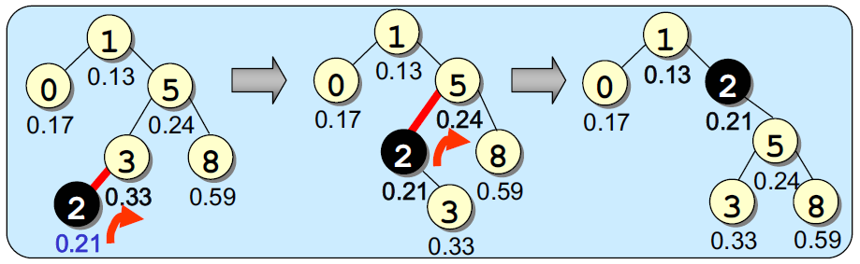
Treap: add
Add x
Add x by BSTree.add(x)
Random a number [0, 1] for this new node
Rotate x until heap property is satisfied

Slide 6
Treap: add
protected override Node add(Node r, object e)
{
if (r == null)
{ r = new TreapNode(e, null, null); SIZE++; }
else
{
int cmp = compareTo(e, r.e);
if (cmp < 0)
{
r.left = add(r.left, e);
if (((TreapNode)r.left).priority < ((TreapNode)r).priority)
r = rotateLeftChild(r);
}
else
{
r.right = add(r.right, e);
if (((TreapNode)r.right).priority < ((TreapNode)r).priority)
r = rotateRightChild(r);
}
}
return r;
}

Slide 7
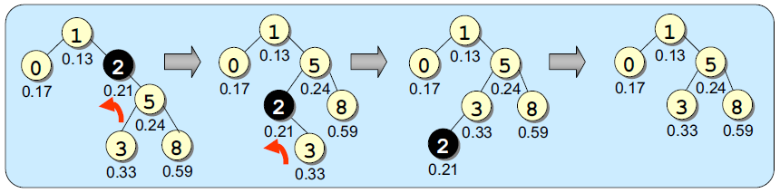
Treap: remove
Remove x
Find node x
Rotate until node x is leaf node
Remove node x

Slide 8
Treap: remove
protected override Node remove(Node r, object e)
{
if (r == null) return r;
int cmp = compareTo(e, r.e);
if (cmp < 0) r.left = remove(r.left, e);
else if (cmp > 0) r.right = remove(r.right, e);
else
{
if (r.left == null || r.right == null)
{
r = r.left == null ? r.right : r.left;
SIZE--;
}
else // Has left and right nodes
{
if (((TreapNode)r.left).priority < ((TreapNode)r.right).priority)
r = rotateLeftChild(r);
else
r = rotateRightChild(r);
if (r == null) r.left = null;
else r = remove(r, e);
}
}
return r;
}

Slide 9
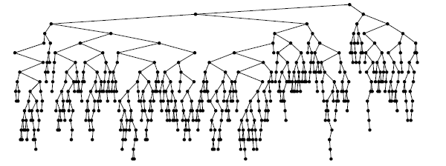
Treap: Complexity
Depth = O(log n)
Add remove contain = O(log n)
Not unique (random)
Good for sorted data
Add 1 to 500 to Treap

